Slide 1




I Will Have Order! Optimizing Orders for Fair Reviewer Assignment
Justin Payan & Yair Zick

Slide 2








Peer Review
Papers must be reviewed by suitable reviewers!

Slide 3


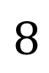
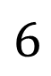
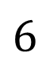
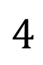
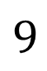
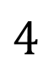
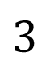
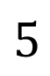
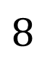
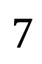
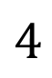
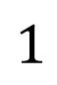
Reviewer Assignment Problem
Given affinity scores
$$5$$
$$4$$
$$8$$
$$4$$
$$9$$
$$6$$
$$1$$
$$8$$
$$3$$
$$4$$
$$6$$
$$7$$

Slide 4
Reviewer Assignment Problem
Given affinity scores
Widely used (OpenReview, CMT, etc)
Roughly correlate with reviewer expertise and interest
High affinity is good for papers & conferences!
$$5$$
$$4$$
$$8$$
$$4$$
$$9$$
$$6$$
$$1$$
$$8$$
$$3$$
$$4$$
$$6$$
$$7$$

Slide 5


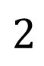
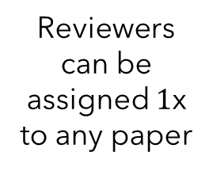
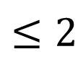
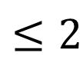
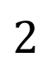
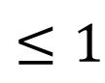
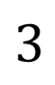
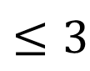
Reviewer Assignment Problem
Given affinity scores
Paper Requirements:
Reviewer Load Bounds:
$$≤2$$
$$2$$
$$5$$
$$4$$
$$8$$
$$4$$
Reviewers can be assigned $1$x to any paper
$$≤3$$
$$2$$
$$9$$
$$6$$
$$1$$
$$8$$
$$≤1$$
$$3$$
$$3$$
$$4$$
$$6$$
$$7$$
$$≤2$$

Slide 6
Reviewer Assignment Problem
Given affinity scores
Paper Requirements:
Reviewer Load Bounds:
$$≤2$$
$$2$$
$$5$$
$$4$$
$$8$$
$$4$$
Reviewers can be assigned $1$x to any paper
$$≤3$$
$$2$$
$$9$$
$$6$$
$$1$$
$$8$$
$$≤1$$
$$3$$
$$3$$
$$4$$
$$6$$
$$7$$
$$≤2$$
Assume uniform for now,
general case later

Slide 7
Reviewer Assignment Problem
Given affinity scores
Paper Requirements:
Reviewer Load Bounds:
$$≤2$$
$$2$$
$$5$$
$$4$$
$$8$$
$$4$$
Reviewers can be assigned $1$x to any paper
$$≤3$$
$$2$$
$$9$$
$$6$$
$$1$$
$$8$$
$$≤1$$
$$3$$
$$3$$
$$4$$
$$6$$
$$7$$
$$≤2$$
Goal:
Allocation of reviewers to papers

Slide 8
Reviewer Assignment Problem
Given affinity scores
$$5$$
$$4$$
$$8$$
$$4$$
$$9$$
$$6$$
$$1$$
$$8$$
$$3$$
$$4$$
$$6$$
$$7$$
Goal:
Allocation of reviewers to papers
High affinity (welfare/USW)
Fast to compute
Adapts to new constraints

Slide 9
Reviewer Assignment Problem
Given affinity scores
$$5$$
$$4$$
$$8$$
$$4$$
$$9$$
$$6$$
$$1$$
$$8$$
Papers with poorly matched reviewers
may get bad feedback, unfair rejection, etc
$$3$$
$$4$$
$$6$$
$$7$$
Goal:
Allocation of reviewers to papers
High affinity (welfare/USW)
Fair to papers!
Fast to compute
Adapts to new constraints

Slide 10
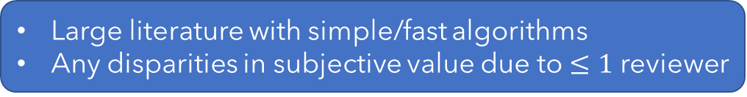
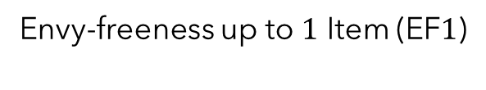
Reviewer Assignment Problem
Given affinity scores
$$5$$
$$4$$
$$8$$
$$4$$
$$9$$
$$6$$
$$1$$
$$8$$
Envy-freeness up to $1$ Item (EF$1$)
Large literature with simple/fast algorithms
Any disparities in subjective value due to $≤1$ reviewer
$$3$$
$$4$$
$$6$$
$$7$$
Goal:
Allocation of reviewers to papers
High affinity (welfare/USW)
Fair to papers!
Fast to compute
Adapts to new constraints

Slide 11
EF1 and Welfare
Theorem (Barman et al. 2019):
There is no polynomial-time $m^{δ}$-approximation for maximizing welfare over all EF$1$ allocations.
Justifies our use of a simple mechanism for EF$1$ allocations called round-robin
Proposition (following Aziz et al. 2015 and Aziz et al. 2016):
Maximizing welfare under round-robin is NP-hard
Goal:
Approximately maximize welfare under round-robin (and a similar mechanism)

Slide 12
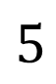
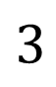
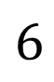
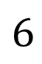
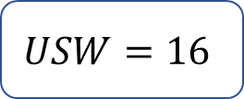
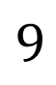
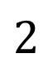
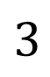
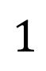
Reviewer Round-Robin
Set an order over papers – papers are assigned 1 reviewer per round
$$USW=16$$
$$6$$
$$5$$
$$3$$
$$2$$
$$9$$
$$6$$
$$3$$
$$1$$

Slide 13
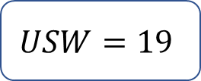
Reviewer Round-Robin
Set an order over papers – papers are assigned 1 reviewer per round
$$USW=16$$
$$6$$
$$5$$
$$3$$
$$2$$
$$9$$
$$6$$
$$3$$
$$1$$
$$USW=19$$
Welfare depends on the order!

Slide 14

Greedy Reviewer Round-Robin
Put papers in order to maximize welfare for round-robin on a subset
$$6$$
$$5$$
$$3$$
$$2$$
$$9$$
$$6$$
$$3$$
$$1$$

Slide 15
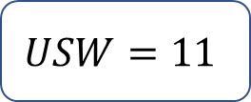
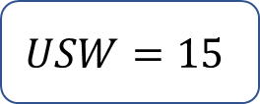
Greedy Reviewer Round-Robin
Put papers in order to maximize welfare for round-robin on a subset
$$USW=11$$
$$6$$
$$5$$
$$3$$
$$2$$
$$9$$
$$6$$
$$3$$
$$1$$
$$USW=15$$

Slide 16
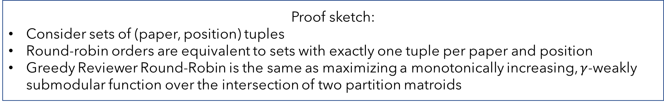
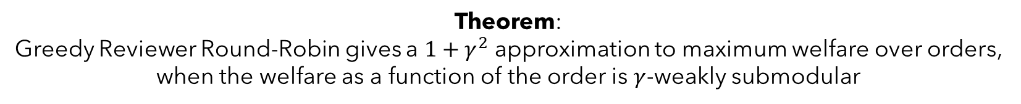
Greedy Reviewer Round-Robin
Theorem:
Greedy Reviewer Round-Robin gives a $1+γ^{2}$ approximation to maximum welfare over orders,
when the welfare as a function of the order is $γ$-weakly submodular
Proof sketch:
Consider sets of (paper, position) tuples
Round-robin orders are equivalent to sets with exactly one tuple per paper and position
Greedy Reviewer Round-Robin is the same as maximizing a monotonically increasing, $γ$-weakly submodular function over the intersection of two partition matroids

Slide 17
Non-Uniform Demands
Given affinity scores
Paper Requirements:
Reviewer Load Bounds:
$$≤2$$
$$2$$
$$5$$
$$4$$
$$8$$
$$4$$
Reviewers can be assigned $1$x to any paper
$$≤3$$
$$2$$
$$9$$
$$6$$
$$1$$
$$8$$
$$≤1$$
$$3$$
$$3$$
$$4$$
$$6$$
$$7$$
$$≤2$$
Assumed uniform before,
now general case

Slide 18
Non-Uniform Demands
Given affinity scores
Paper Requirements:
Reviewer Load Bounds:
$$≤2$$
$$2$$
$$5$$
$$4$$
$$8$$
$$4$$
Reviewers can be assigned $1$x to any paper
$$≤3$$
$$2$$
$$9$$
$$6$$
$$1$$
$$8$$
$$≤1$$
$$3$$
$$3$$
$$4$$
$$6$$
$$7$$
$$≤2$$
Also, speed-ups!
Assumed uniform before,
now general case

Slide 19
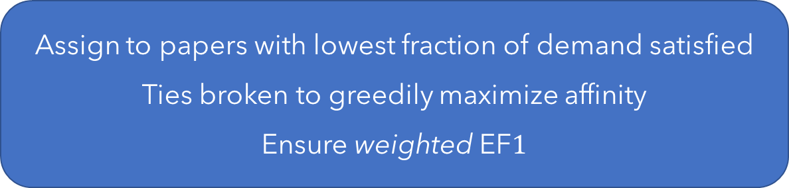
FairSequence
Assign to papers with lowest fraction of demand satisfied
Ties broken to greedily maximize affinity
Ensure weighted EF$1$

Slide 20
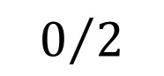
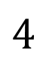
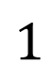
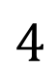
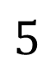
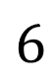
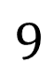
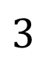
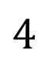
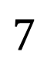
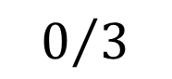
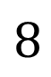
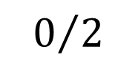


FairSequence
Assign to papers with lowest fraction of demand satisfied
Ties broken to greedily maximize affinity
Ensure weighted EF$1$
$$0/2$$
$$5$$
$$4$$
$$8$$
$$4$$
$$0/2$$
$$9$$
$$6$$
$$1$$
$$8$$
$$0/3$$
$$3$$
$$4$$
$$6$$
$$7$$

Slide 21

FairSequence
Assign to papers with lowest fraction of demand satisfied
Ties broken to greedily maximize affinity
Ensure weighted EF$1$
$$0/2$$
$$5$$
$$4$$
$$8$$
$$4$$
$$1/2$$
$$9$$
$$6$$
$$1$$
$$8$$
$$0/3$$
$$3$$
$$4$$
$$6$$
$$7$$

Slide 22
FairSequence
Assign to papers with lowest fraction of demand satisfied
Ties broken to greedily maximize affinity
Ensure weighted EF$1$
$$0/2$$
$$5$$
$$4$$
$$8$$
$$4$$
$$1/2$$
$$9$$
$$6$$
$$1$$
$$8$$
$$0/3$$
$$3$$
$$4$$
$$6$$
$$7$$

Slide 23
FairSequence
Assign to papers with lowest fraction of demand satisfied
Ties broken to greedily maximize affinity
Ensure weighted EF$1$
$$0/2$$
$$5$$
$$4$$
$$8$$
$$4$$
$$1/2$$
$$9$$
$$6$$
$$1$$
$$8$$
$$0/3$$
$$3$$
$$4$$
$$6$$
$$7$$

Slide 24

FairSequence
Assign to papers with lowest fraction of demand satisfied
Ties broken to greedily maximize affinity
Ensure weighted EF$1$
Etc…
No welfare guarantees, but good in practice
Much faster too!
$${{|A}_{i}|}/{k_{i}}$$
$$0/2$$
5
4
8
4
$$1/2$$
9
6
1
8
$$0/3$$
3
4
6
7

Slide 25

FairSequence – Very Fast!
~10x faster than FairFlow!
~3x faster than TPMS!

Slide 26



Welfare and Fairness
Our Approaches
 | TPMS (OPT) | FairFlow | PR4A | GRRR | FairSeq
USW (% of OPT) | $$100\%$$ | $$100\%$$ | $$98\%$$ | $$98\%$$ | $$99\%$$
# EF$1$ Viol. | $$0$$ | $$0$$ | $$0$$ | $$0$$ | $$0$$
MIDL
 | TPMS (OPT) | FairFlow | PR4A | GRRR | FairSeq
USW (% of OPT) | $$100\%$$ | $$96\%$$ | $$94\%$$ | $$88\%$$ | $$92\%$$
# EF$1$ Viol. | $$473545$$ | $$23344$$ | $$82$$ | $$0$$ | $$0$$
CVPR
 | TPMS (OPT) | FairFlow | PR4A | GRRR | FairSeq
USW (% of OPT) | $$100\%$$ | $$97\%$$ | $$97\%$$ | $$94\%$$ | $$96\%$$
# EF$1$ Viol. | $$134$$ | $$25$$ | $$2$$ | $$0$$ | $$0$$
CVPR ’18

Slide 27

FairSequence Fits the Criteria
Fairness
GRRR and FairSeq are the only approaches that satisfy EF$1$
High USW w.r.t. TPMS (OPT) and algorithms used in practice
~10x speedup compared to fair competitors
Simplicity ➔ flexibility
Welfare
Speed
Flexibility

Slide 28

Look for FairSequence!
Available in
Ask your conference organizer today if FairSequence is right for you!

Slide 29


Thanks!
Read the full paper on arxiv:
arxiv.org/abs/2108.02126
justinpayan.github.io

